Slide 1
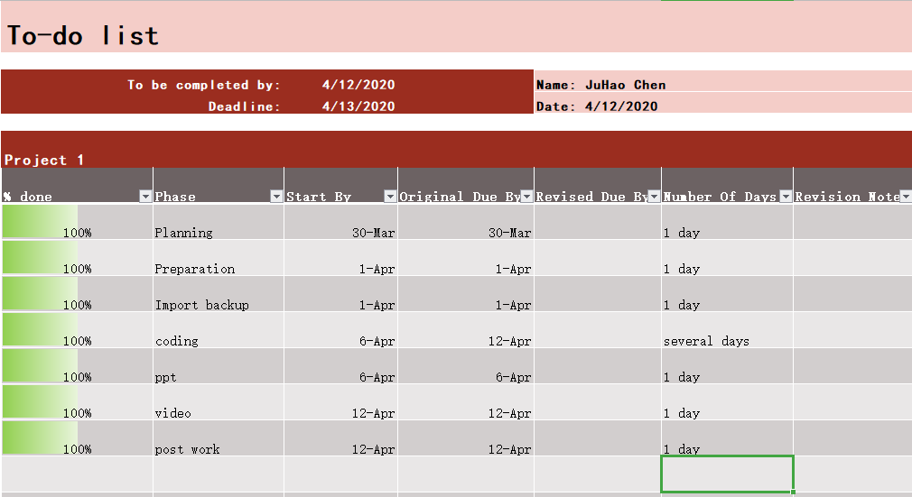
TO-DO LIST FOR JuHao CHEN

Slide 2
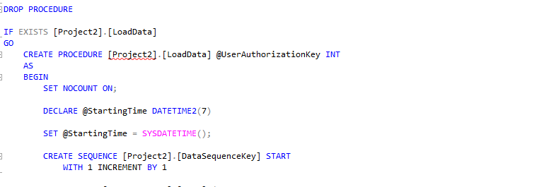
Create The procedure

Slide 3
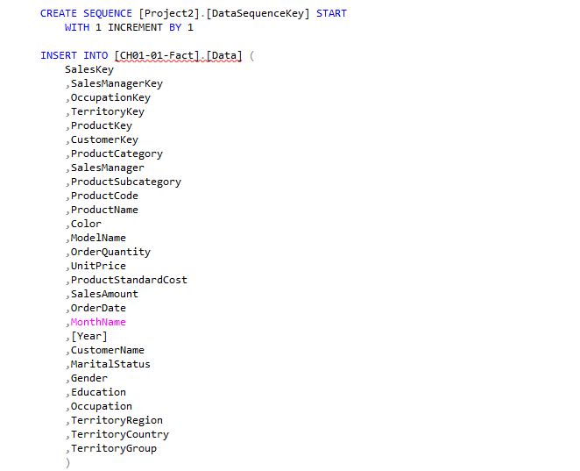
Make insert

Slide 4
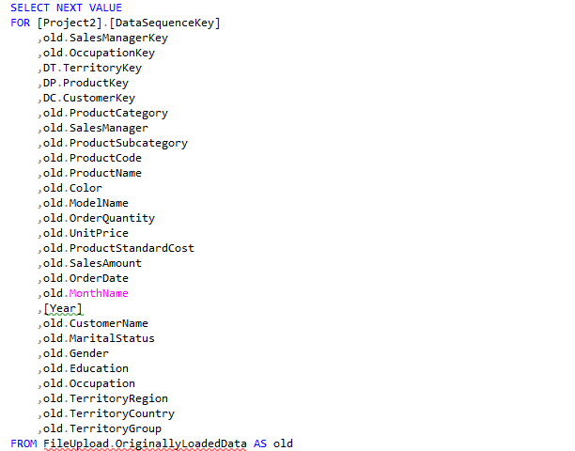

Slide 5
